Slide 1




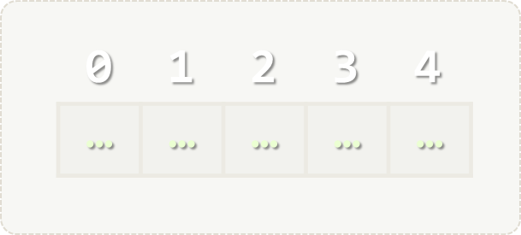
Arrays
Processing Sequences of Elements
Arrays
SoftUni Team
Technical Trainers
Software University
http://softuni.bg

Slide 2

Table of Contents
Defining, Initializing and Processing Arrays
Reading Arrays from the Console
Using for Loop to Read Arrays
Using String.Split(…)
Printing Arrays at the Console
Using the foreach Loop
Using String.Join(…)
Arrays – Exercises

Slide 3
Questions?
sli.do #8850

Slide 4
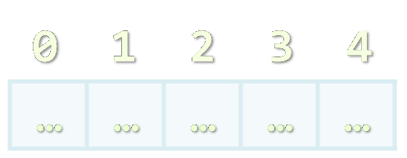
Arrays
Working with Arrays of Elements

Slide 5
What are Arrays?
In programming array is a sequence of elements
Elements are numbered from 0 to Length-1
Elements are of the same type (e.g. integers)
Arrays have fixed size (Array.Length) – cannot be resized
0 1 2 3 4
Element index
Array of 5 elements
… | … | … | … | …
Element of an array

Slide 6
Working with Arrays
All elements are initially == 0
Allocating an array of 10 integers:
Assigning values to the array elements:
Accessing array elements by index:
int[] numbers = new int[10];
The Length holds the number of array elements
for (int i = 0; i < numbers.Length; i++)
numbers[i] = 1;
The [] operator accesses elements by index
numbers[5] = numbers[2] + numbers[7];
numbers[10] = 1; // IndexOutOfRangeException

Slide 7
Days of Week – Example
The days of week can be stored in array of strings:
string[] days = {
"Monday",
"Tuesday",
"Wednesday",
"Thursday",
"Friday",
"Saturday",
"Sunday"
};
Expression | Value
days[0] | Monday
days[1] | Tuesday
days[2] | Wednesday
days[3] | Thursday
days[4] | Friday
days[5] | Saturday
days[6] | Sunday

Slide 8
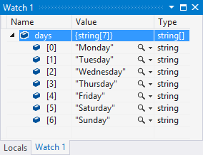
Problem: Day of Week
Enter a day number [1…7] and print the day name (in English) or "Invalid day!"
string[] days = { "Monday", "Tuesday", "Wednesday", "Thursday", "Friday", "Saturday", "Sunday" };
int day = int.Parse(Console.ReadLine());
if (day >= 1 && day <= 7)
Console.WriteLine(days[day - 1]);
else
Console.WriteLine("Invalid day!");
Check your solution here: https://judge.softuni.bg/Contests/Practice/Index/172#0

Slide 9

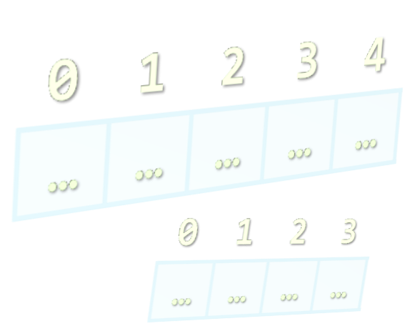
Reading Arrays from the Console
Using String.Split() and Select()

Slide 10
Reading Arrays From the Console
First, read from the console the array length:
Next, create an array of given size n and read its elements:
int n = int.Parse(Console.ReadLine());
int[] arr = new int[n];
for (int i = 0; i < n; i++)
{
arr[i] = int.Parse(Console.ReadLine());
}

Slide 11
Problem: Reverse an Array of Integers
Read an array of integers (a number n + n lines of integers), reverse it and print its elements (on a single line, space separated):
3
10
20
30
30 20 10
4
-1
20
99
5
5 99 20 -1
Check your solution here: https://judge.softuni.bg/Contests/Practice/Index/172#1

Slide 12
Solution: Reverse an Array of Integers
// Read the array (a number n + n lines of integers)
var n = int.Parse(Console.ReadLine());
var arr = new int[n];
for (int i = 0; i < n; i++)
arr[i] = int.Parse(Console.ReadLine());
// Print the elements from the last to the first
for (int i = n-1; i >= 0; i--)
Console.Write(arr[i] + " ");
Console.WriteLine();
Check your solution here: https://judge.softuni.bg/Contests/Practice/Index/172#1

Slide 13
Problem: Sum, Min, Max, First, Last, Average
Write a program to read n integers and print their sum, min, max, first, last and average values:
5
12
20
-5
37
8
Sum = 72
Min = -5
Max = 37
First = 12
Last = 8
Average = 14.4
4
50
20
25
40
Sum = 135
Min = 20
Max = 50
First = 50
Last = 40
Average = 33.75
Check your solution here: https://judge.softuni.bg/Contests/Practice/Index/172#2

Slide 14
Solution: Sum, Min, Max, First, Last, Average
Use System.Linq to enable aggregate functions like .Max() and .Sum()
using System.Linq;
…
var n = int.Parse(Console.ReadLine());
var nums = new int[n];
for (int i = 0; i < n; i++)
nums[i] = int.Parse(Console.ReadLine());
Console.WriteLine("Sum = {0}", nums.Sum());
Console.WriteLine("Min = {0}", nums.Min());
// TODO: print also max, first, last and average values
Check your solution here: https://judge.softuni.bg/Contests/Practice/Index/172#2

Slide 15
Reading Array Values from a Single Line
Arrays can be read from a single line of space separated values:
Or even write the above as a single line of code:
2 8 30 25 40 72 -2 44 56
string.Split(' ') splits string by space and produces string[]
string values = Console.ReadLine();
string[] items = values.Split(' ');
int[] arr = new int[items.Length];
for (int i = 0; i < items.Length; i++)
arr[i] = int.Parse(items[i]);
Use System.Linq to enable .Select()
int[] arr = Console.ReadLine().Split(' ')
.Select(int.Parse).ToArray();

Slide 16
Problem: Last K Numbers Sums
Enter two integers n and k
Generate the following sequence of n integers:
The first element is: 1
All other elements = sum of the previous k elements
Example: n = 9, k = 5
120 = 4 + 8 + 16 + 31 + 61
6
3
Sequence:
1 1 2 4 7 13
8
2
Sequence:
1 1 2 3 5 8 13 21
9
5
Sequence:
1 1 2 4 8 16 31 61 120
+
1 1 2 4 8 16 31 61 120
Check your solution here: https://judge.softuni.bg/Contests/Practice/Index/172#3

Slide 17
Solution: Last K Numbers Sums
var n = int.Parse(Console.ReadLine());
var k = int.Parse(Console.ReadLine());
var seq = new long[n];
seq[0] = 1;
for (int current = 1; current < n; current++)
{
var start = Math.Max(0, current - k);
var end = current - 1;
long sum = // TODO: sum the values of seq[start … end]
seq[current] = sum;
}
// TODO: print the sequence seq[]
Check your solution here: https://judge.softuni.bg/Contests/Practice/Index/172#3

Slide 18
Problem: Triple Sum (a + b == c)
Write a program to read an array of integers and find all triples of elements a, b and c, such that a + b == c (a stays left from b)
1 1 1 1
4 2 8 6
2 7 5 0
3 1 5 6 1 2
No
4 + 2 == 6
2 + 6 == 8
2 + 5 == 7
2 + 0 == 2
7 + 0 == 7
5 + 0 == 5
3 + 2 == 5
1 + 5 == 6
1 + 1 == 2
1 + 2 == 3
5 + 1 == 6
1 + 2 == 3
Check your solution here: https://judge.softuni.bg/Contests/Practice/Index/172#4

Slide 19
Solution: Triple Sum (a + b == c)
int[] nums = Console.ReadLine().Split(' ')
.Select(int.Parse).ToArray();
for (int i = 0; i < nums.Length; i++)
for (int j = i + 1; j < nums.Length; j++)
{
int a = nums[i];
int b = nums[j];
int sum = a + b;
if (nums.Contains(sum))
Console.WriteLine($"{a} + {b} == {sum}");
}
TODO: print "No" when no triples are found
Check your solution here: https://judge.softuni.bg/Contests/Practice/Index/172#4

Slide 20

Working with Arrays
new int[]
Live Exercises in Class (Lab)

Slide 21


Printing Arrays at the Console
Using foreach and String.Join()

Slide 22
Printing Arrays on the Console
To print all array elements, a for-loop can be used
Separate elements with white space or a new line
Example:
string[] arr = {"one", "two", "three", "four", "five"};
// Process all array elements
for (int index = 0; index < arr.Length; index++)
{
// Print each element on a separate line
Console.WriteLine("arr[{0}] = {1}", index, arr[index]);
}

Slide 23
Problem: Rounding Numbers
Read an array of real numbers (space separated values), round them in "away from 0" style and print the output as in the examples:
0.9 1.5 2.4 2.5 3.14
-5.01 -1.599 -2.5 -1.50 0
0.9 => 1
1.5 => 2
2.4 => 2
2.5 => 3
3.14 => 3
-5.01 => -5
-1.599 => -2
-2.5 => -3
-1.50 => -2
0 => 0
Check your solution here: https://judge.softuni.bg/Contests/Practice/Index/172#5

Slide 24

Solution: Rounding Numbers
Rounding turns each value to the nearest integer
What to do when the value is exactly between two integers?
double[] nums = Console.ReadLine()
.Split(' ').Select(double.Parse).ToArray();
int[] roundedNums = new int[nums.Length];
for (int i = 0; i < nums.Length; i++)
roundedNums[i] = (int) Math.Round(nums[i],
MidpointRounding.AwayFromZero);
for (int i = 0; i < nums.Length; i++)
Console.WriteLine($"{nums[i]} -> {roundedNums[i]}");
Check your solution here: https://judge.softuni.bg/Contests/Practice/Index/172#5

Slide 25
Printing Arrays with foreach / String.Join(…)
Use foreach-loop:
Use string.Join(separator, array):
int[] arr = { 10, 20, 30, 40, 50};
foreach (var element in arr)
Console.WriteLine(element)
int[] arr = { 1, 2, 3 };
Console.WriteLine(string.Join(", ", arr)); // 1, 2, 3
string[] strings = { "one", "two", "three", "four" };
Console.WriteLine(string.Join(" - ", strings)); // one - two - three - four

Slide 26
Problem: Reverse Array of Strings
Read an array of strings (space separated values), reverse it and print its elements:
Reversing array elements:
a b c d e
e d c b a
-1 hi ho w
w ho hi -1
exchange
a
b
c
d
e
Check your solution here: https://judge.softuni.bg/Contests/Practice/Index/172#6

Slide 27
Solution: Reverse Array of Strings
var nums = Console.ReadLine().Split(' ').ToArray();
for (int i = 0; i < nums.Length / 2; i++)
SwapElements(nums, i, nums.Length - 1 - i);
Console.WriteLine(string.Join(" ", nums));
static void SwapElements(string[] arr, int i, int j)
{
var oldElement = arr[i];
arr[i] = arr[j];
arr[j] = oldElement;
}
Check your solution here: https://judge.softuni.bg/Contests/Practice/Index/172#6

Slide 28
Solution: Reverse Array – Functional Style
A functional style solution to the "reverse string array" problem:
A functional-style solution to "reverse integer array" problem
Console.WriteLine(string.Join(" ",
Console.ReadLine().Split(' ').Reverse()));
Console.WriteLine(string.Join(" ",
Console.ReadLine().Split(' ')
.Select(int.Parse).Reverse()));
Check your solution here: https://judge.softuni.bg/Contests/Practice/Index/172#6

Slide 29


Arrays – Exercises

Slide 30
Problem: Sum Arrays
Write a program that reads two arrays of integers and sums them
When the elements are less, duplicate the smaller array a few times
1 2 3 4
2 3 4 5
1 2 3 4 5
2 3
1 2 3 4 5
2 3 2 3 2
5 4 3
2 3 1 4
5 4 3 5
2 3 1 4
3 5 7 9
3 5 5 7 7
7 7 4 9
Check your solution here: https://judge.softuni.bg/Contests/Practice/Index/172#7

Slide 31
Solution: Sum Arrays
var arr1 = Console.ReadLine()
.Split(' ').Select(int.Parse).ToArray();
var arr2 = // TODO: read the second array of integers
var n = Math.Max(arr1.Length, arr2.Length);
var sumArr = new int[n];
for (int i = 0; i < n; i++)
sumArr[i] =
arr1[i % arr1.Length] +
arr2[i % arr2.Length];
Console.WriteLine(string.Join(" ", sumArr));
Loop the array: end → start
arr[len] → arr[0]
arr[len+1] → arr[1]
…
Check your solution here: https://judge.softuni.bg/Contests/Practice/Index/172#7

Slide 32
Problem: Condense Array to Number
Reads an array of integers and condense them by summing adjacent couples of elements until a single integer is obtained:
2 10 3
2 4 1 2
5 0 4 1 2
12 13
6 5 3
5 4 5 3
25
11 8
9 9 8
18 17
19
35
Check your solution here: https://judge.softuni.bg/Contests/Practice/Index/172#8

Slide 33
Solution: Condense Array to Number
int[] nums = Console.ReadLine()
.Split(' ').Select(int.Parse).ToArray();
while (nums.Length > 1)
{
int[] condensed = new int[nums.Length - 1];
for (int i = 0; i < nums.Length - 1; i++)
condensed[i] = // TODO: sum nums
nums = condensed;
}
Console.WriteLine(nums[0]);
0
1
2
nums[] :
2
10
3
condensed[] :
12
13
Check your solution here: https://judge.softuni.bg/Contests/Practice/Index/172#8

Slide 34
Problem: Extract Middle 1, 2 or 3 Elements
Write a method to extract the middle 1, 2 or 3 elements from array of n integers
n = 1 → 1 element
even n → 2 elements
odd n → 3 elements
Read n integers from the console and print the middle elements
5
{ 5 }
2 3 8 1 7 4
{ 8, 1 }
1 2 3 4 5 6 7
{ 3, 4, 5 }
2 8 12 7 3 4 5 33 -2 8 22 4
{ 4, 5 }
Check your solution here: https://judge.softuni.bg/Contests/Practice/Index/172#9

Slide 35
Solution: Extract Middle 1, 2 or 3 Elements
static int[] ExtractMiddleElements(int[] arr)
{
int start = arr.Length / 2 - 1;
int end = start + 2;
if (arr.Length == 1) start = end = 0;
else if (arr.Length % 2 == 0) end--;
int[] mid = new int[end - start + 1];
// TODO: copy arr[start … end] → mid[]
return mid;
}
start
end
1 2 3 4 5 6 7
Check your solution here: https://judge.softuni.bg/Contests/Practice/Index/172#9

Slide 36
Arrays – Exercises
Live Exercises in Class (Lab)

Slide 37
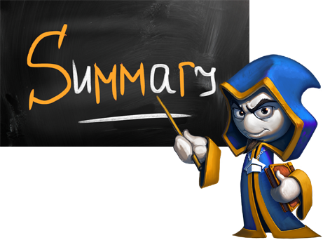
Summary
Arrays hold sequence of elements
Elements are numbered from 0 to length-1
Creating (allocating) an array:
Accessing array elements by index:
Printing array elements:
int[] numbers = new int[10];
numbers[5] = 10;
Console.Write(string.Join(" ", arr));

Slide 38








Arrays
https://softuni.bg/courses/programming-fundamentals

Slide 39
License
This course (slides, examples, demos, videos, homework, etc.) is licensed under the "Creative Commons Attribution-NonCommercial-ShareAlike 4.0 International" license
Attribution: this work may contain portions from
"Fundamentals of Computer Programming with C#" book by Svetlin Nakov & Co. under CC-BY-SA license

Slide 40






Free Trainings @ Software University
Software University Foundation – softuni.org
Software University – High-Quality Education, Profession and Job for Software Developers
softuni.bg
Software University @ Facebook
facebook.com/SoftwareUniversity
Software University @ YouTube
youtube.com/SoftwareUniversity
Software University Forums – forum.softuni.bg

